Slide 1

Event Management
By: 216 Project Group

Slide 2

Planning the Process
Dream
Design
Build

Slide 3
Overview

Slide 4

Technologies used
Backend : .Net MVC Framework
Frontend: HTML, CSS
Database: SQL

Slide 5
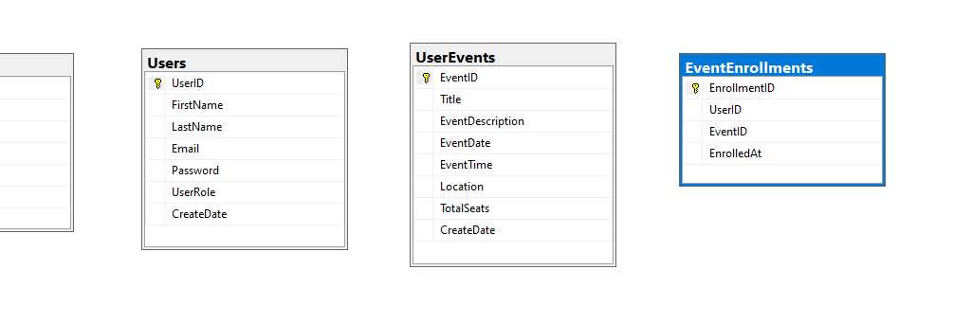
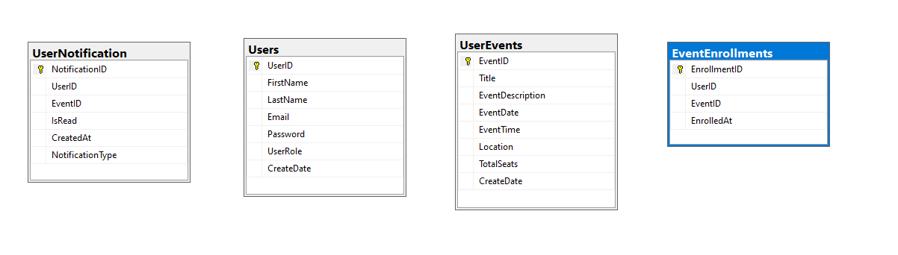
DATABASE Tables

Slide 6
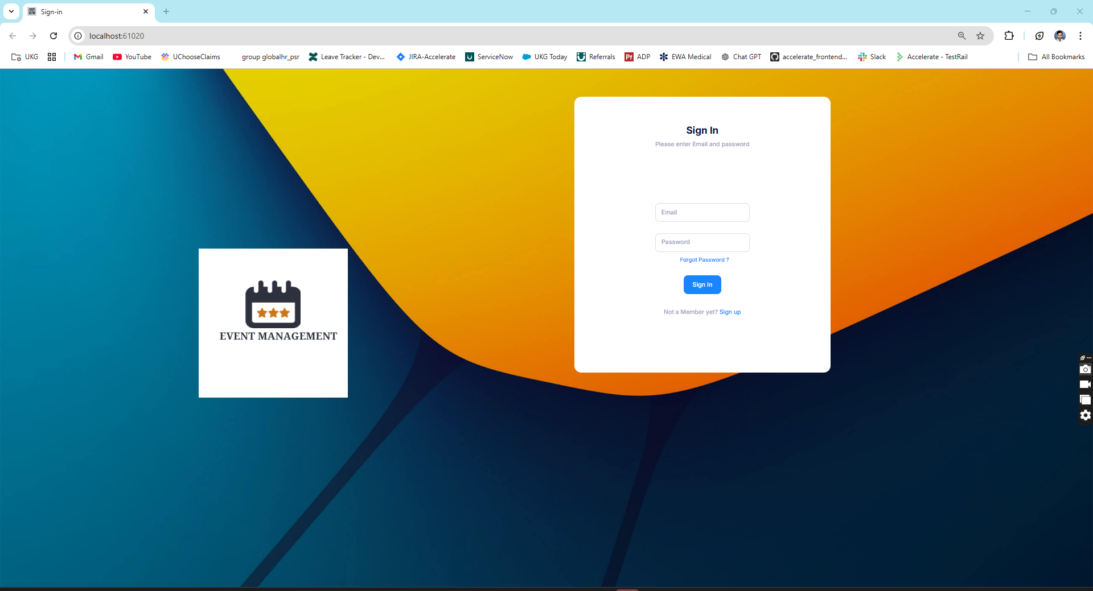
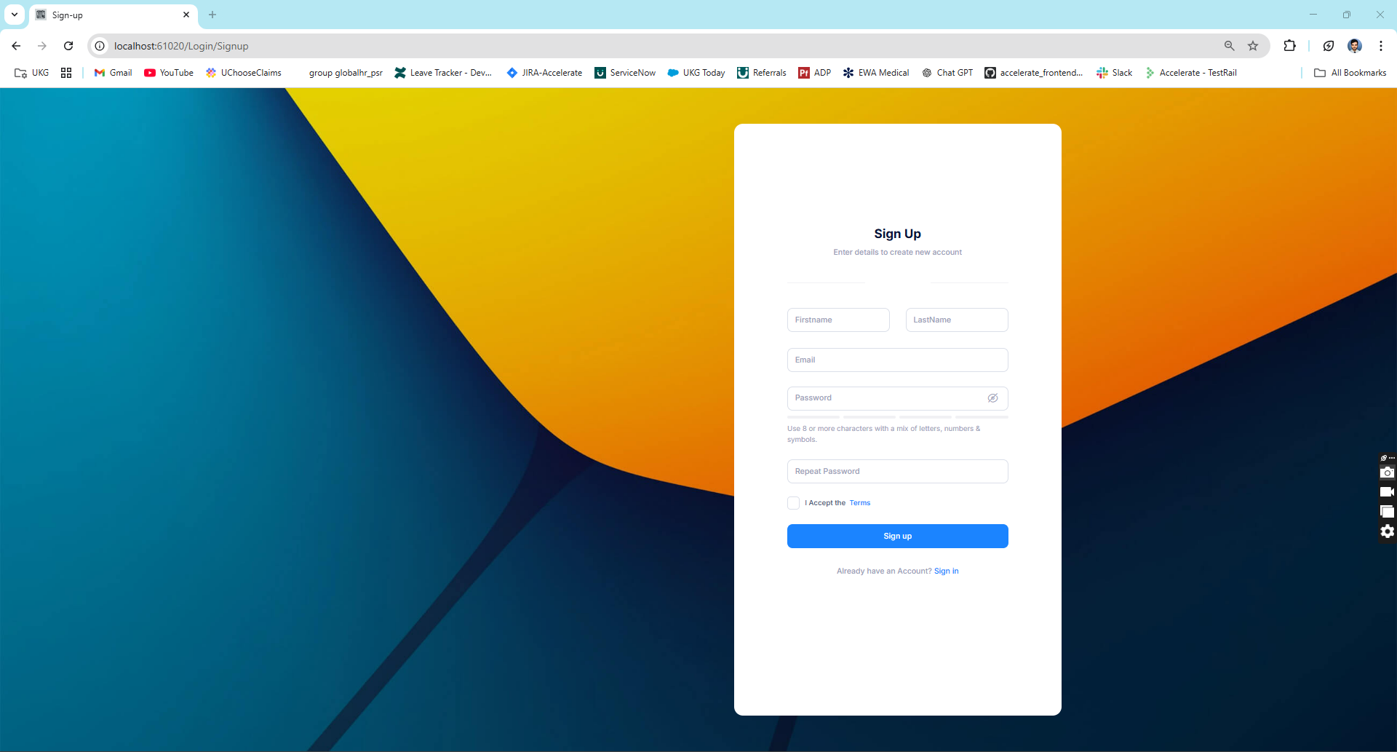
Common Screen
Login
SignUP

Slide 7
Screens
Admin Portal

Slide 8
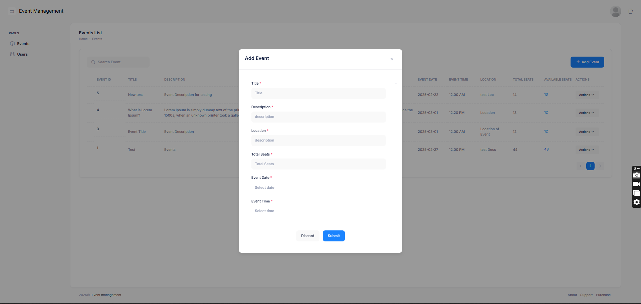
Create Event

Slide 9
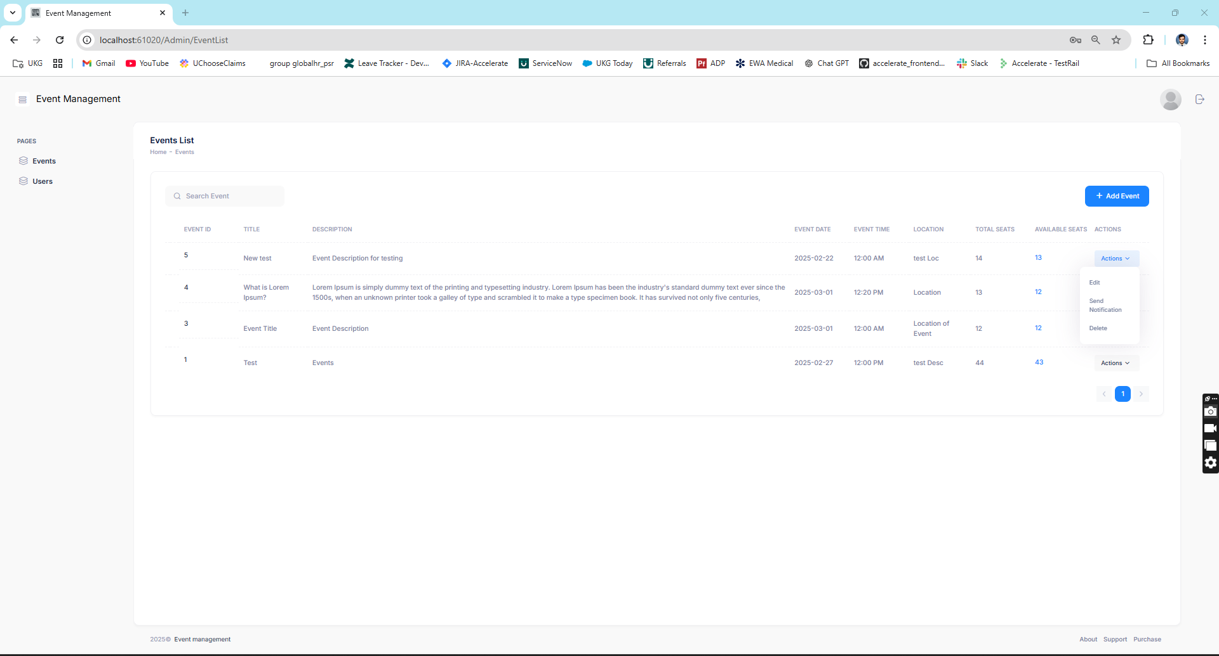
Manage Event

Slide 10
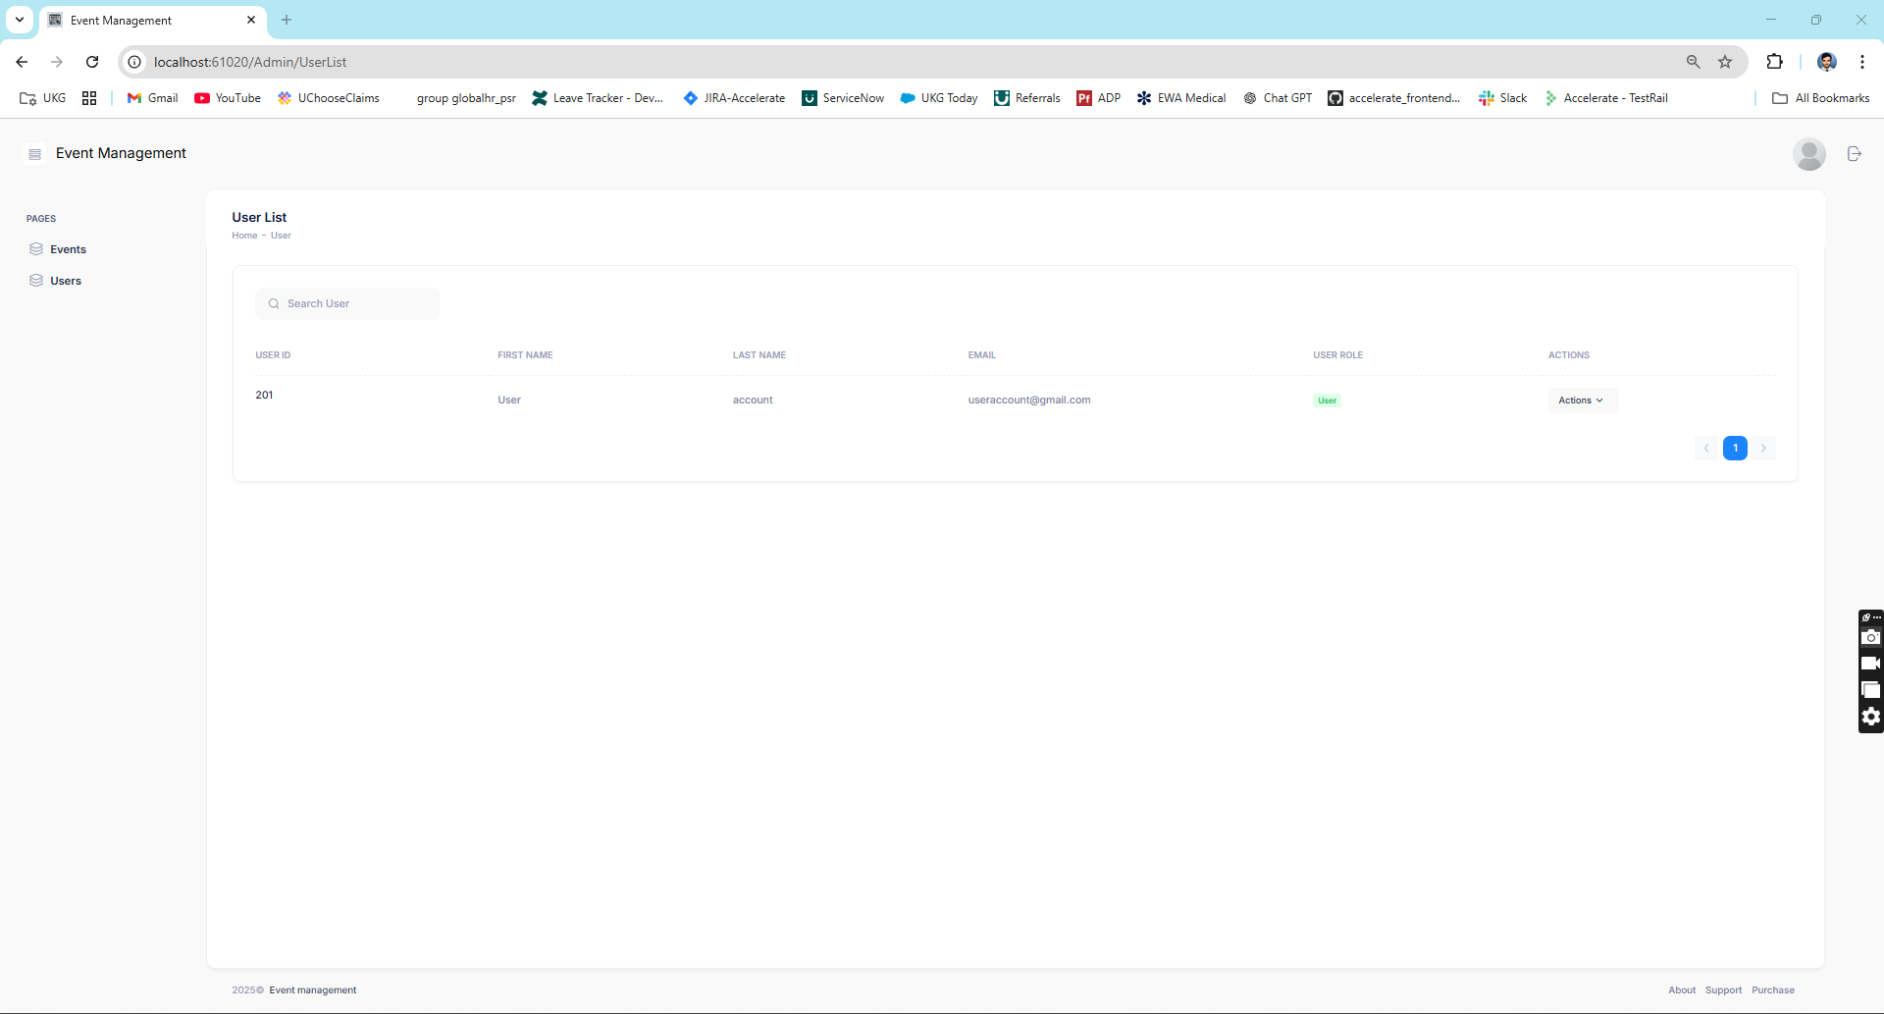
User Management List

Slide 11
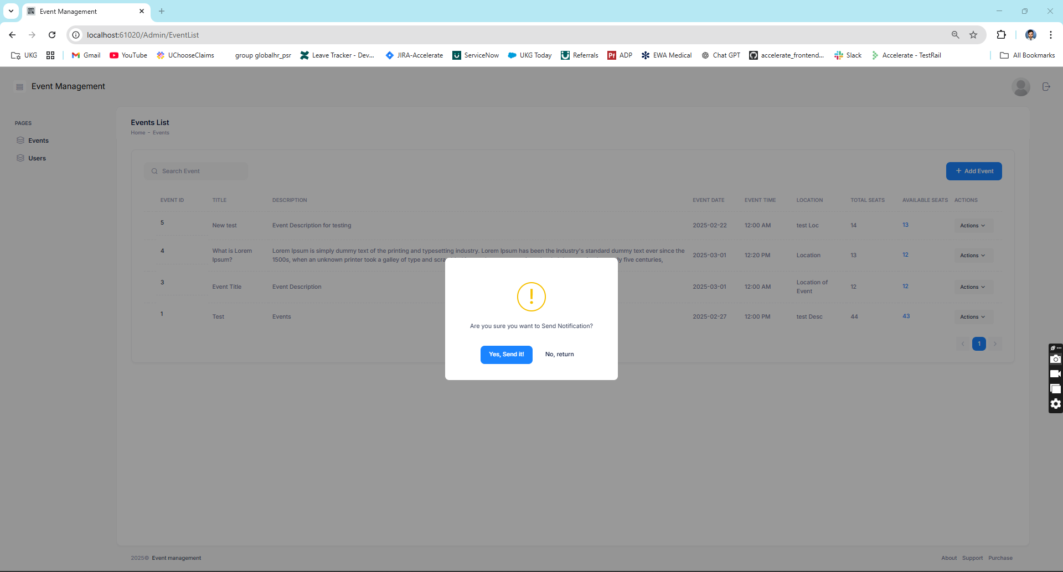
Send Notification

Slide 12
Screens
User Portal

Slide 13
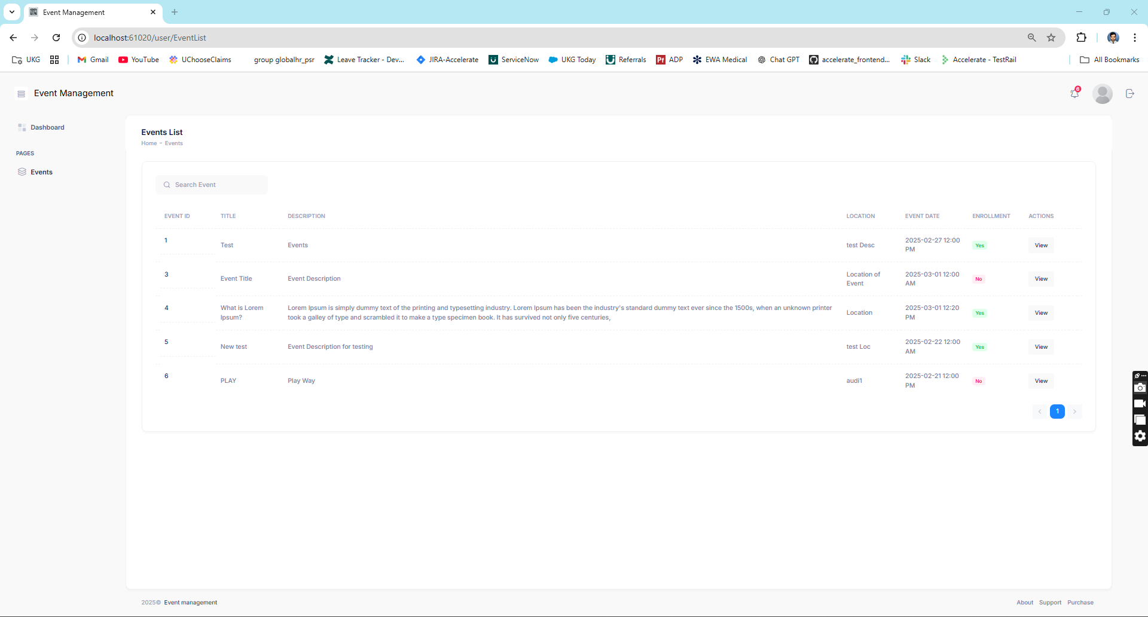
Event List

Slide 14
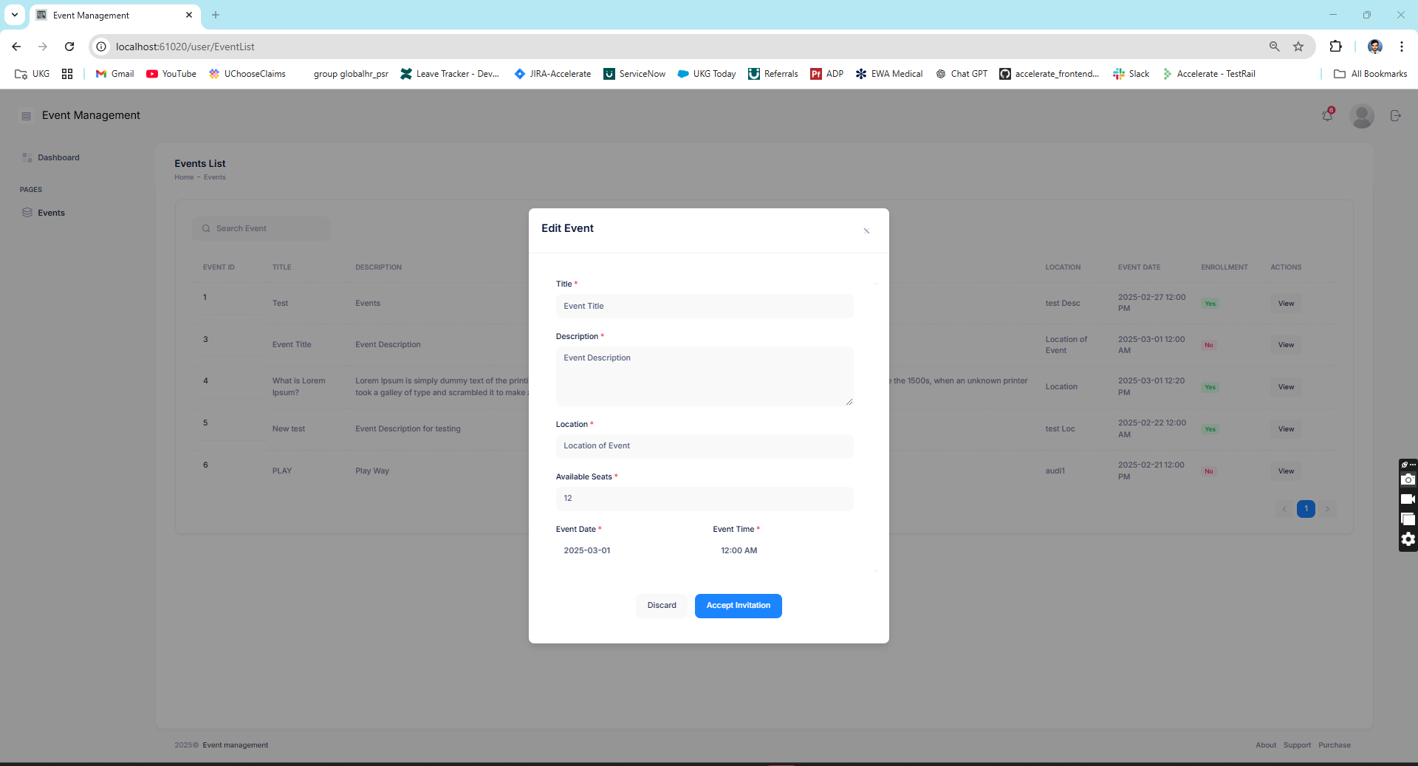
View Event Detail and Accept Event

Slide 15
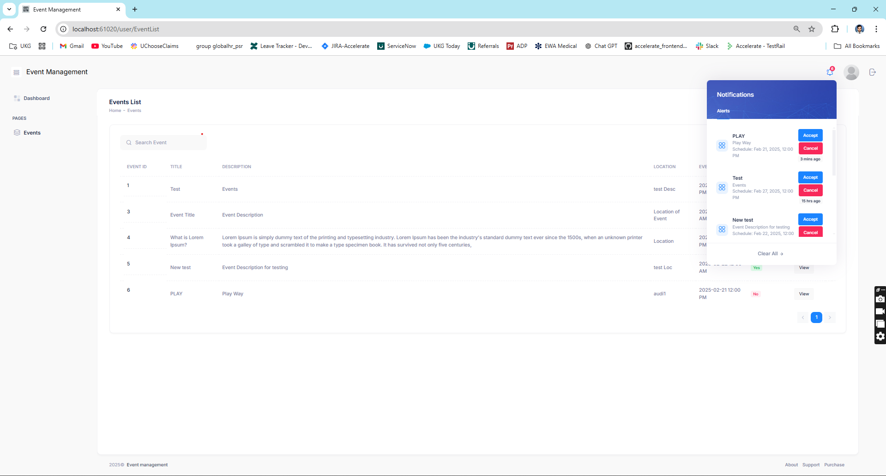
Notifications

Slide 16

Thank you

